Slide 1



Fast Incremental Proximity Search in Large Graphs
Purnamrita Sarkar
Andrew W. Moore
Amit Prakash
Notes:
Hi I am going to talk about finding nearest neighbors in large graphs very very quickly. This is joint work with …

Slide 2




Recommender systems
Alice
What are the top k movie recommendations for Alice?
Bob
Charlie
Brand, M. (2005). A Random Walks Perspective on Maximizing Satisfaction and Profit. SIAM '05.
Notes:
Lets start with a few examples which require ranking on large graphs. Take for example recommender networks.
Here we have a bipartite graph of customers and movies. A customer has a link to a movie if he/she rated that movie. Now the question is…

Slide 3
Content-based search in databases^{{1,2}}
maximum
paper-has-word
Find top k papers matching “SVM” in Citeseer
margin
Paper #1
classification
paper-cites-paper
paper-has-word
large
Paper #2
scale
SVM
1. Dynamic personalized pagerank in entity-relation graphs. (Soumen Chakrabarti, WWW 2007)
2. Balmin, A., Hristidis, V., & Papakonstantinou, Y. (2004). ObjectRank: Authority-based keyword
search in databases. VLDB 2004.
Notes:
Another example is content based search in databases. We can represent the citeseer dataset by a graph of paper and word-nodes. Papers are connected via citation. Words are connected to the paper if they appeared in the title of the paper. Now we want to ask….

Slide 4
Proximity measures on graphs
For ranking we need proximity measures
  Personalized pagerank
  Hitting/commute times
  Truncated hitting and commute times
We will present an algorithm to compute nearest neighbors in truncated hitting and commute times on the fly.
Empirically show that these truncated measures perform better than the others in most cases.
Notes:
Motivate random walks before the outline

Slide 5
Outline
Ranking Problem on graphs
Background
  Random walks
  Standard and truncated measures
  Previous work
Our contribution
  Theoretical justification
  Algorithm sketch
Experimental results
Notes:
I just talked about ranking problems on graphs. Now we will go over some background material. Then I will talk about our contribution in this paper. I will conclude with experiments.

Slide 6
Random walks
Start at 1
2
1
5
3
4

Slide 7
Random walks
Start at 1
Pick a neighbor i uniformly at random
Move to i
t=1
2
1
5
3
4

Slide 8
Random walks
Start at 1
Pick a neighbor i uniformly at random
Move to i
Continue.
t=1
2
1
5
3
4
t=2

Slide 9
Random walks
Start at 1
Pick a neighbor i uniformly at random
Move to i
Continue.
t=1
2
1
5
3
If the random walk hits a node many times,
then its close to the start node!
t=3
Hitting time!
4
t=2
Notes:
The main idea of a random walk is to start at a node, and then pick a neighbor uniformly at random, and move to tat neighbor. And then we continue this process.
naturally if I hit a node many times in my random walk, I am close to it. This is the intuition behind hitting times.

Slide 10
Hitting time from i to j
Graph G
i
j
h(i,j)=?
Notes:
Lets be more specific about the definition.

Slide 11
Hitting time from i to j
Graph G
P(i,n₁)
n₁
i
j
P(i,n₂)
n₂
h(i,j)=1+…

Slide 12
Hitting time from i to j
Graph G
h(n₁,j)
P(i,n₁)
n₁
i
j
h(n₂,j)
P(i,n₂)
n₂
h(i,j)=1+P(i,n₁)*h(n₁,j)+P(i,n₂)*h(n₂,j)

Slide 13
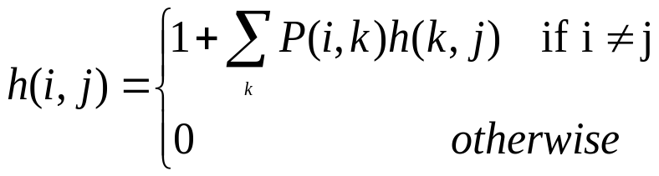

Random walk-based proximity measures
Hitting time can be defined recursively
Symmetric version: commute time
Aldous, D., & Fill, J. A. (2001). Reversible markov chains.
Notes:
Remove the first definition

Slide 14
Hitting & Commute times: Drawbacks
Predictive power
Hitting time and Commute times often take into account very long paths.^{1,2}
You are more prone to pick up popular entities.^{1,2}
  Bad for personalization.
  Alice likes cartoons, so her top 10 recommendations should not be the 10 most popular movies.
As a result these do not perform well for link prediction^{1,2}.
Liben-Nowell, D., & Kleinberg, J. The link prediction problem for social networks CIKM '03.
Brand, M. (2005). A Random Walks Perspective on Maximizing Satisfaction and Profit. SIAM '05.
Notes:
Its sensitive to parts of the graph which are unrelated to the query node.
As a result of this its also more prone to pick up high degree nodes.

Slide 15
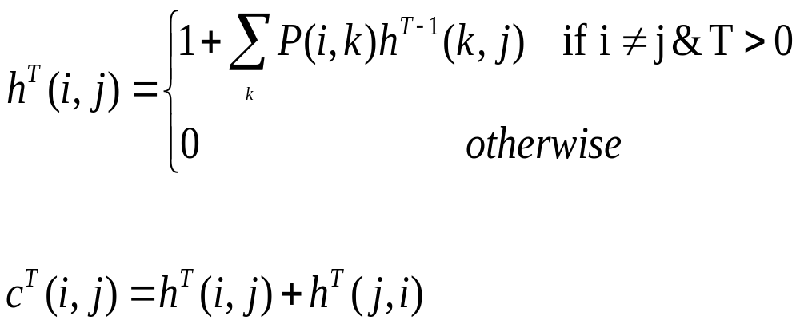
A better proximity measure based on truncated random walks
We use a truncated version of hitting and commute times, which only considers paths of length at most T
Sarkar, P., & Moore, A. (2007). A tractable approach to finding closest truncated-commute-time
neighbors in large graphs. Proc. UAI.
Notes:
We denote truncated hitting time by h^T, where only paths of length at most T are considered. Just look at T-1 truncated hitting time of its neighbors.

Slide 16
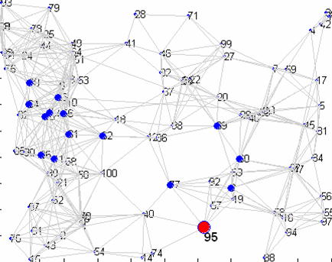
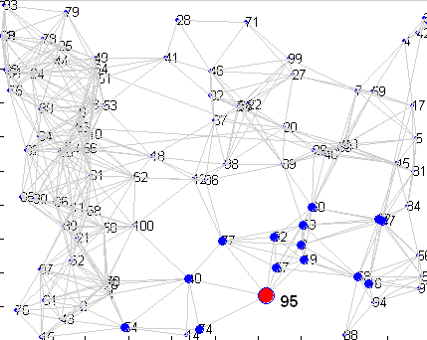
15 nearest neighbors of node 95 (in red)
Un-truncated vs truncated hitting time from a node
Un-truncated hitting time
Truncated hitting time
Random walk gets lost here.

Slide 17
Truncated Hitting & Commute times
For small T
  Are not sensitive to long paths
  Do not necessarily favor high degree nodes
These are also easier to compute compared to un-truncated hitting and commute times
Important for
personalized search!

Slide 18
Nearest neighbors of a node:
Computational complexity of truncated measures
Hitting time to node j
Have to fill up entire matrix!
O(num_nodes*T*num_edges)!!
Can compute using Dynamic programming in O(T*num_edges)
Hitting time from node i
Previous Work : << O(num_nodes²)
H^{T}[i,j]=h^{T}(i,j)
Notes:
What are you doing? Make that clear.
Based on this we devised out previous algorithm Granch.

Slide 19
Outline
Ranking Problem on graphs
Background
  Random walks
  Standard and truncated measures
  Previous work
Proposed work
  Theoretical justification
  Algorithm sketch
Experimental results

Slide 20
GRANCH: computing hitting time to a node
hitting time to node j
Use dynamic programming to fill up interesting patches in the column
H^{T}[i,j]=h^{T}(i,j)
Sarkar, P., & Moore, A. (2007). A tractable approach to finding closest truncated-commute-time
neighbors in large graphs. Proc. UAI.
Notes:
In previous work we showed how to discover potential nearest neighbors without computing the entire column, which is hitting times from all nodes to node j. We effectively end up computing interesting patches in the column.

Slide 21
GRANCH: computing hitting time from a node
Fill up all columns
H^{T}[i,j]=h^{T}(i,j)

Slide 22
GRANCH: computing hitting time from a node
hitting time from node i
H^{T}[i,j]=h^{T}(i,j)
Notes:
May be remove

Slide 23
GRANCH: Pros & Cons
Pros:
  The amortized time and space per node is small
  Great for computing nearest neighbors for all nodes!
Cons:
  Large pre-processing time: Looks at entire graph
  Significant space required: caches neighborhoods for all nodes
What if the graph changes between two consecutive queries?
➔ Need fast, on the fly, space-efficient search algorithms!
Notes:
Motivate before showing the outline slide.

Slide 24
Outline
Ranking Problem on graphs
Background
  Random walks
  Standard and truncated measures
  Previous work
Proposed work
  Theoretical justification
  Algorithm sketch
Experimental results

Slide 25
Proposed work
  Return k approximate nearest neighbors of the query node in truncated commute time without looking at entire graph.
Hitting time FROM
Hitting time TO
☹ | ☺
☺ | ☹
Previous Work: GRANCH
DP
Sampling
Current Work

Slide 26
Proposed work: sketch
Return k approximate nearest neighbors of the query node with truncated commute time ≤ 2τ
Theoretical justification: number of nodes within 2τ truncated commute time is small.
  #nodes with hitting time ≤ τ from the query is small
  #nodes with hitting time ≤ τ to the query is small
We present an algorithm which adaptively finds a neighborhood which contains all nodes with commute time ≤ 2τ w.h.p.
Then we perform ranking on these nodes
Notes:
Come back to 21

Slide 27
Outline
Ranking Problem on graphs
Background
  Random walks
  Standard and truncated measures
  Previous work
Proposed work
  Theoretical justification
  Algorithm sketch
Experimental results

Slide 28

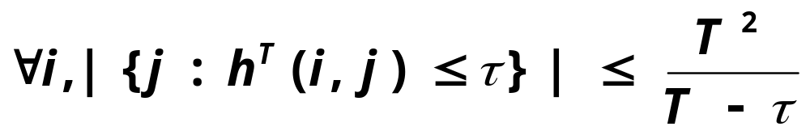
Number of nodes with hitting time ≤ τ from the query
G
How many nodes will I hit within τ time?
What is the size of
the set ?
Notes:
Make everything comic sans
Remove G/ replace with graph?
If T and tau are constant, then this is a small number

Slide 29

Number of nodes with hitting time ≤ τ to the query
G
How many nodes will hit me within τ time?
What is the size of
the set ?
Directed graphs:
Not too many nodes will have a lot of neighbors
within a small hitting time to them.
Notes:
Say it out in words in 22. Say it in a positive way

Slide 30
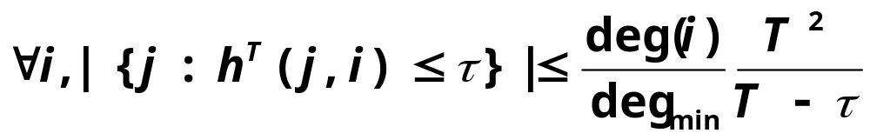
Number of nodes with hitting time ≤ τ to the query
G
How many nodes will hit me within τ time?
What is the size of
the set ?
Stronger guarantee for
undirected graphs!
Notes:
Mention reversibility

Slide 31
Outline
Ranking Problem on graphs
Background
  Random walks
  Standard and truncated measures
  Previous work
Proposed work
  Theoretical justification
  Algorithm sketch
Experimental results

Slide 32
Algorithm sketch : Combining sampling and dynamic programming
Use sampling to estimate hitting time from node i
Maintain a neighborhood NB(i) around node i
Use estimated hitting times and dynamic programming to compute bounds on commute time between node i and nodes in NB(i).
As we expand the neighborhood these bounds get tighter.
Rank using bounds on commute times.
Notes:
First idea was to just use to+from. But we combine the information

Slide 33
Sampling for computing hitting time from a node
T=5
10
9
11
2
8
7
1
5
3
6
4
1

Slide 34
Sampling for computing hitting time from a node
T=5
10
9
11
2
8
7
1
5
3
6
4
1 5

Slide 35
Sampling for computing hitting time from a node
T=5
10
9
11
2
8
7
1
5
3
6
4
1 5 9

Slide 36
Sampling for computing hitting time from a node
T=5
10
9
11
2
8
7
1
5
3
6
4
1 5 9 5

Slide 37
Sampling for computing hitting time from a node
T=5
10
9
11
2
8
7
1
5
3
6
4
1 5 9 5 7

Slide 38
Sampling for computing hitting time from a node
T=5
10
h(1,5) = 1
h(1,9) = 2
h(1,7) = 4
h(1,-) = 5
9
11
2
8
7
1
5
3
6
4
1 5 9 5 7

Slide 39
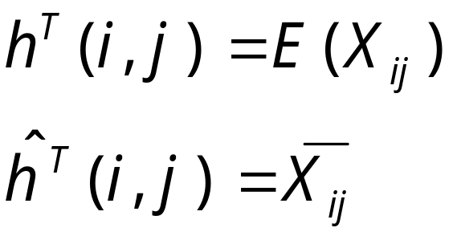
Sampling for computing hitting time from a node
Define X_{ij} as the first hitting time at j
If the random walk never hits j, X(i,j) = T
Notes:
INTUITION

Slide 40
Sample complexity bounds
Estimating h(i,j), j=1,…,n
  [Theorem]: The number of samples needed to achieve low error with high probability is proportional to log(n).
Retrieving top k neighbors
  [Theorem]: Number of samples needed to retrieve top k neighbors with high probability is small when the gap between the true k^{th} and k+1th neighbor is large.
Notes:
Say what n is

Slide 41
Outline
Ranking Problem on graphs
Background
  Random walks
  Standard and truncated measures
  Previous work
Proposed work
  Theoretical justification
  Algorithm sketch
Experimental results

Slide 42
Citeseer graph: Average query processing time
Find k nearest neighbors of a query node in truncated hitting/commute times
628,000 nodes. 2.8 Million edges on a single CPU machine.
  Sampling (7,500 samples) 0.7 seconds
  Exact truncated commute time: 88 seconds
  Hybrid commute time: 4 seconds
Notes:
Check the sample seconds

Slide 43
Keyword-author-citation graphs
words
papers
authors
Existing work use Personalized Pagerank (PPV) .
We present quantifiable link prediction tasks
We compare PPV with truncated hitting and commute times.
Dynamic personalized pagerank in entity-relation graphs. (Chakrabarti, S., WWW 2007)
Balmin, A., Hristidis, V., & Papakonstantinou, Y. (2004). ObjectRank: Authority-based keyword
search in databases. VLDB 2004.
Notes:
CHANGE the links

Slide 44
Word Task
words
papers
authors

Slide 45
Word Task
words
papers
authors
Rank the papers for these words.
See if the paper comes up in top 1,3,5,…

Slide 46
Author Task
words
papers
authors
Rank the papers for these authors.
See if the paper comes up in top 1,3,5,…

Slide 47
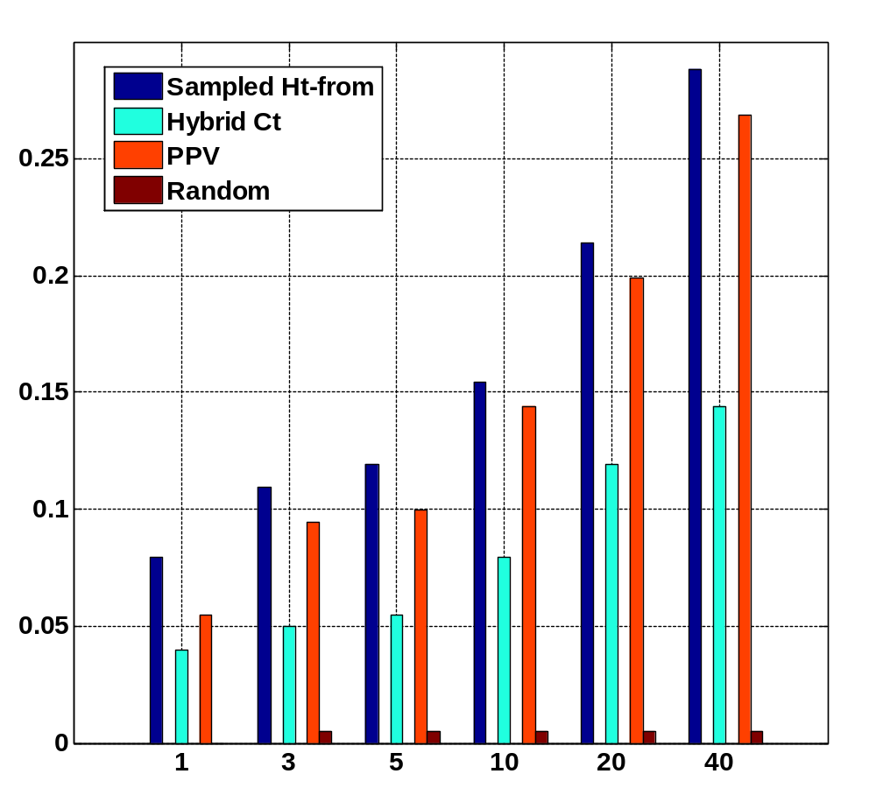
Word Task
Fraction of queries with the held out paper in top k
k

Slide 48
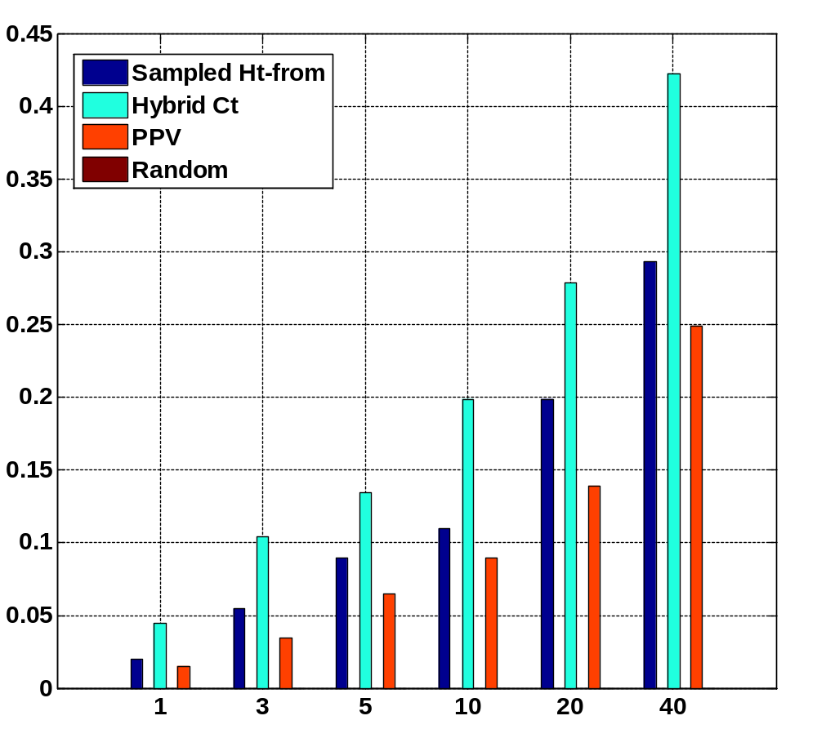
Author Task
Fraction of queries with the held out paper in top k
k

Slide 49
Conclusion
On-the-fly algorithm to compute approximate nearest neighbors in truncated hitting and commute time.
If the graph changes between consecutive queries, our algorithm is fast.
On most quantifiable link prediction tasks our measures outperform personalized pagerank.
On a single CPU machine, we can process queries in 4 seconds on average in a graph with 600,000 nodes and 3 million edges.
Notes:
Emphasize the fact that its incremental, fast even if the graph changes between queries
Incremental=on the fly.

Slide 50
Acknowledgement
Soumen Chakrabarti
Anupam Gupta
Geoffrey Gordon
Tamás Sarlós
Martin Zinkevich

Slide 51
Conclusion
On-the-fly algorithm to compute approximate nearest neighbors in truncated hitting and commute time.
If the graph changes between consecutive queries, our algorithm is fast.
On most quantifiable link prediction tasks our measures outperform personalized pagerank.
On a single CPU machine, we can process queries in 4 seconds on average in a graph with 600,000 nodes and 3 million edges.
Notes:
Emphasize the fact that its incremental, fast even if the graph changes between queries
Incremental=on the fly.

Slide 52
Thank you

Slide 53
Hitting & Commute times: Drawbacks
Computational complexity
Recent “efficient” approximation algorithm for computing commute times in “undirected graphs^{”1.}
For directed graphs, these measures are hard to compute.
For many real world applications
  Underlying graphs are directed
  We need fast incremental algorithms for computing nearest neighbors of a query.
1. Spielman, D., & Srivastava, N. (2008). Graph sparsification by effective resistances. STOC'08

Slide 54
Approximate nearest neighbor
Given τ, k,ε for any node i, find k other nodes y within truncated commute time 2τ , s.t.
c^{T}_{iy} · c^{T}_{ix}(1+ε)
where x is the true k-th-nearest neighbor.
Notes:
Come back to 21

Slide 55

Personalized pagerank
Personalized pagerank for node i
  Start from node i
  At any timestep jump to node i with probability c
  Stop when the distribution does not change.
  Solve for v such that
  r is a distribution
Notes:
vague

Slide 56
Properties of Truncated Hitting & Commute times
For small T:
  Are not sensitive to long paths
  Do not favor high degree nodes
    For a randomly generated undirected graph, average correlation coefficient (R_{avg}) with the degree-sequence is
      R_{avg} with truncated hitting time is -0.087
      R_{avg} with untruncated hitting time is -0.75
Important for
personalized search!
Notes:
REORDER (remember to say what T is)

